Slide 1
Persepolis-AI
Empowering Education
Ali Noshad - Milad Goudarzi - Reza Paki - Mohsen Shahverdi

Slide 2
We do not want another ChatGPT! We already have a perfect one.
First of All

Slide 3
What is it all about?
AI-based assistant helping you learn more effectively
What is this tool already capable of?
Are the slides too much? No worries. Our tool will summarize them for you.
Do your slides have figures? No problem. Our model will interpret it for you.
Do you feel confused about learning all these topics? No worries. Our tool will provide you with a clear roadmap of what to learn.
Do you struggle remembering each and every concept? No worries. Our telegram bot is there for you.

Slide 4
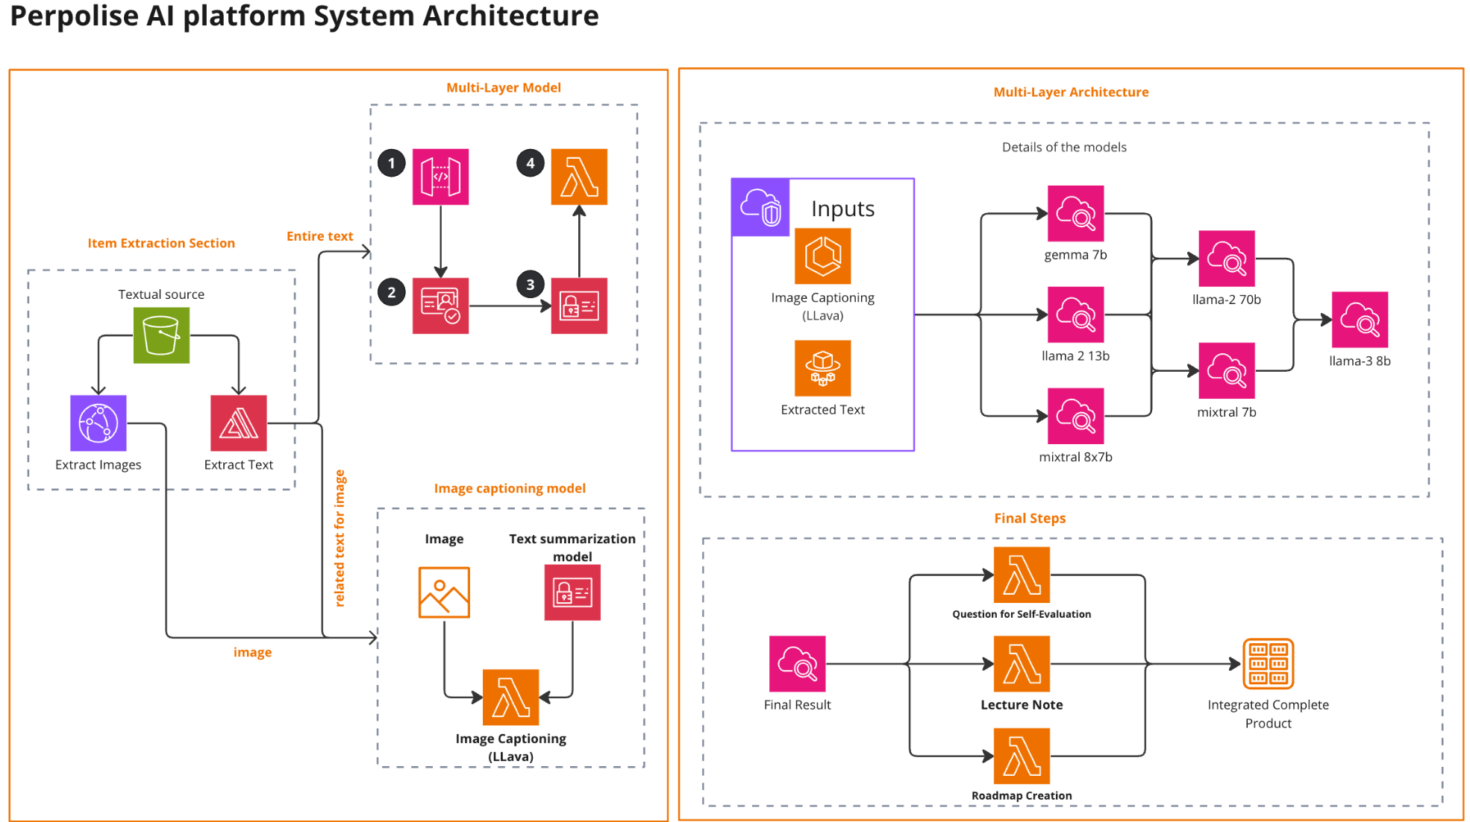

Slide 5
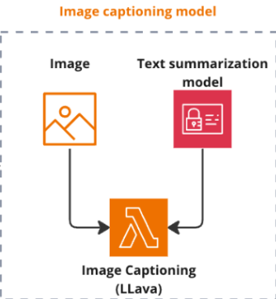
Why this?

Slide 6

The image features a stream of water flowing through a forest, surrounded by rocks. The scene appears to be serene and natural, with the water flowing smoothly over the rocks. The presence of the forest and the rocks adds to the overall beauty of the scene.
The image features a stream of water flowing through a forest, surrounded by rocks. The scene is serene and picturesque, with the water flowing gently over the rocks. The context provided suggests that the image may be related to a lecture or a course on data analytics, stream processing, and semantic technologies. The presence of the stream and the surrounding forest may serve as a metaphor for the flow of data and the need to process and analyze it in real-time to make informed decisions.

Slide 7
UI Demo

Slide 8
Future Work
Enhanced Gamification Features
Personalized Learning Pathways
Expanding Content and Formats
User Feedback and Co-creation
Scalability and Broader Impact Studies
Integration with Educational Systems

Slide 9
Thank you!
Q&A

